Slide 1

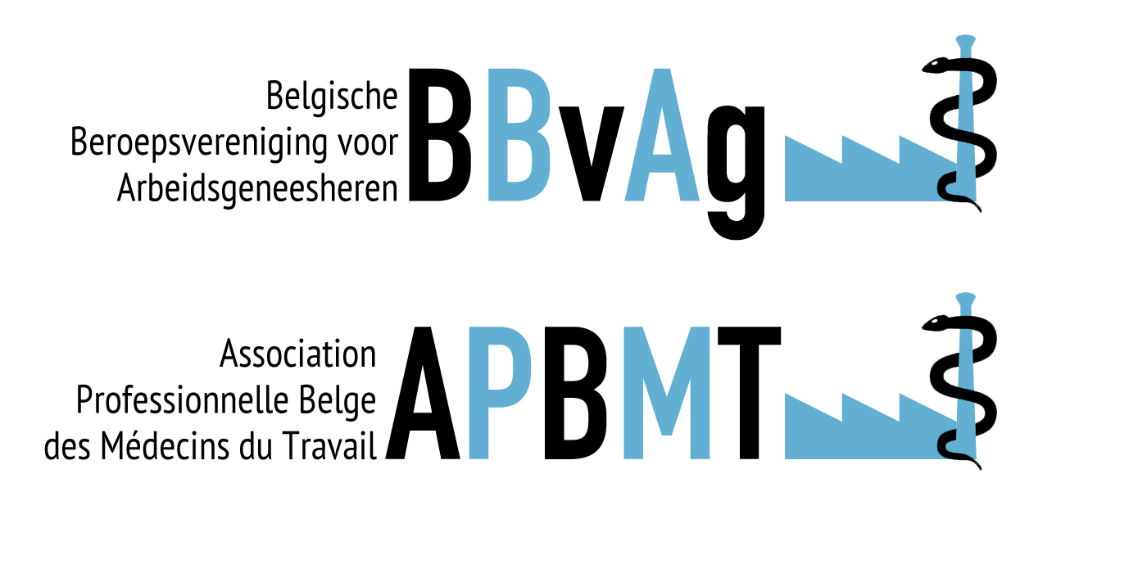
Occupational medicine:
a journey through Europe
Arbeidsgeneeskunde
over de grenzen heen:
een reis door Europa
November 14th, 2024
European Union of Medical Specialists (UEMS)
Dr. Olga Gerbosch,
Belgian delegate B.B.v.A.g. - A.P.B.M.T.

Slide 2
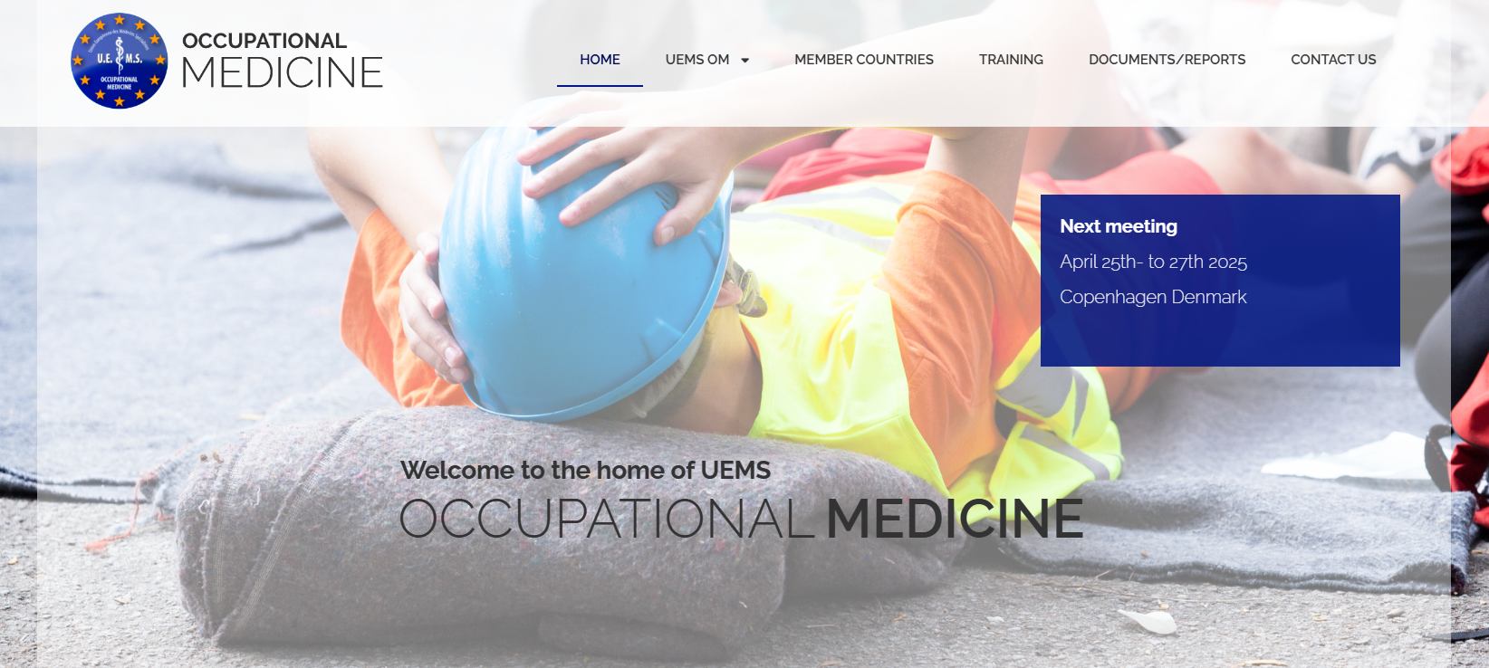
https://uems-occupationalmedicine.org/

Slide 3
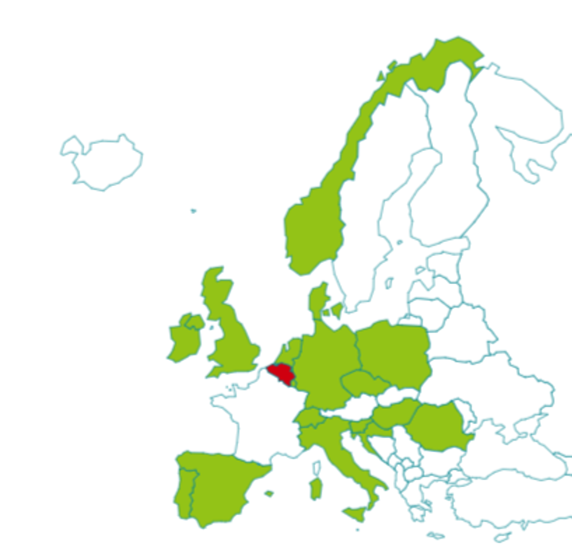
What is the function of the UEMS OM?
Comparing ‘Good practices’
Fifth European Assessment in Occupational Medicine
21 October 2024 – Brussels
Lobbying in the EU commission and parliament
How does the Belgian OM compares to other European countries?
Questionaire from the Belgian POV.
Respons from 17 of 22 represented countries.
Occupational Health Physician / doctor = ‘OH P’
(PAAA Preventieadviseur Arbeidsarts / CPMT Conseiller en Prévention médecin du travail)

Slide 4
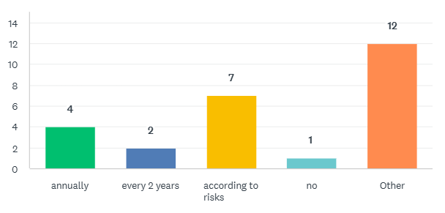
Obligatory medical examination

Slide 5
Obligatory medical examination
Depends on regulation e.g. lead can be more frequent depending on blood lead, ionising radiation is annual and asbestos can be 2 yearly depending on licensing. (UK)
Yearly for minors (<18 years) or older than 50 years, every 2 years for those in between.
It is also obligatory when there is a substantial change in the work environment that may have a noxious impact upon workers’ health. (Portugal)
Compulsory only for certain risks. Voluntary for the rest, but in practice a very high proportion of workers get annual examinations not related to risks. (Spain)
Medical screening only if there is a special exposure or special work conditions, which cannot be controlled sufficiently by technical or organisational methods. (Switzerland)

Slide 6
Obligatory medical examination
Seafarers, divers have obligatory health examinations. Night workers can ask about it. (Denmark)
Entry exams obligatory, periodical according to risk category, according to law:
    small risk categories 1 and 2 obligatory in case of employer decision each 4/6 years
    after 50 4/2 years
    high risk categories 3 and 4 obligatory each 2/1 year
    specific regulation for selected occupations: drivers, pilots, railway personnel etc. (Czech R)
Although not legally mandatory, it is usual to have annual medical check-ups because it is the most visible activity in the eyes of the employer, who pays the service. (Hungary)

Slide 7
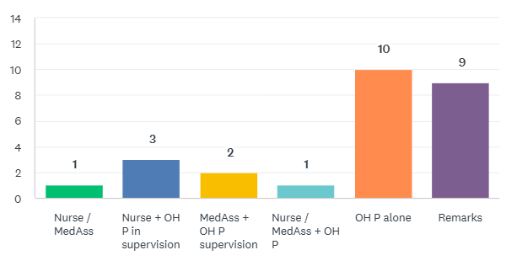
Who carries out the periodic medical examinations?

Slide 8
Who carries out the periodic medical examinations?
Depends, some regs e.g. lead and IR require an appointed OH P.
  Others can be done by nurse or doctor.
  Healthcare professional can delegate specific parts of exam to OH technician or to nurse. (UK)
Doctor, nurse and when needed Psychologist. (Croatia)
According to law, the OH P is required to perform the examination, but occasionally this is done by GP supervised by an OH P.
Medical assistants are involved in performing different procedures like spirometry, audiometry, collection
  of blood samples etc. (Romania)
OH P is medical speciality, exams allowed to GP´s / OH P only according to law (Czech R)

Slide 9
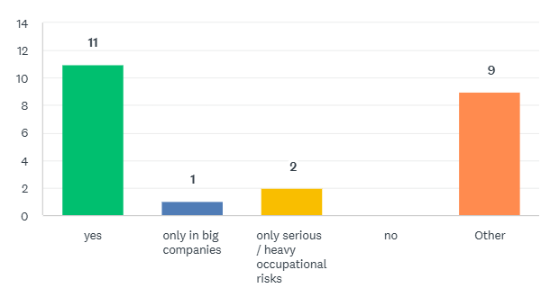
Each employee has access to an OH P.

Slide 10
Each employee has access to an OH P.
about 50% of workers have access to OH service / not necessarily Dr. (UK)
Large companies and public sector. (Ireland)
Only when they suffer from a suspected occupational disease. (Denmark)
Every employee, not for self employed. (Slovenia, Spain)
Theoretically, yes. In real life, no. (Portugal, Romania, Switzerland)
Competence of GP´s and OH physicians is the same at company level. (Czech R)

Slide 11

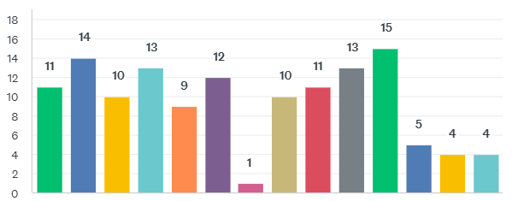
What types of consultations exist?

Slide 12
What types of consultations exist?
In case of a return to work, it is obligatory only if it exceeds 30 days. (Portugal)
Varies across businesses, sometimes employees have access to OH sometimes only on employer referral. (UK)

Slide 13
How are the consultations carried out?
Physically 7 > 4 Digital (video or phone) / both depending on the situation
Mostly defined by the Health policy of the employer (Switzerland)
Digital medical check-ups were admitted only during pandemic time. (Romania)

Slide 14
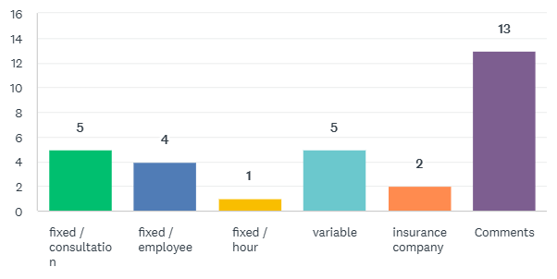
Financial Compensation

Slide 15
Financial Compensation
The employer pays 0,14% of the salaries of his employees for occupational health surveillance. This amount includes all services offered. (Luxembourg)
The Insurance company (Croatia, Switzerland)
The contract for occupational medicine services is negotiated between the employer and the provider of these services. Sometimes fixed per employee, sometimes individually depending on number of examinations or hours of presence.
  (Germany, Hungary, Norway, Romania)

Slide 16
How long must the employer pay guaranteed salary in the event of illness?
5 days (Hungary, Romania)
20 days, guaranteed 80% salary (Slovenia)
30 days; but for people older than 50y -> 14 days (Poland)
42 days (Croatia, Germany)
3 months, employed statutory, some companies in house support for 1-2 years. May reduce in amount during this time. (UK)
2 years (The Netherlands)

Slide 17
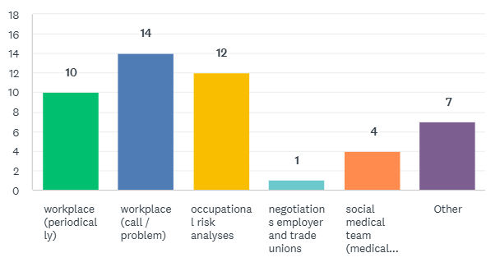
Other Obligations (legal)

Slide 18
Other Obligations
The negotiations with employer and trade unions exist but are not mandatory as well as the one's with human resources. (Luxembourg)
Health and safety committees in companies. But occupational risk analyses, periodical workplace visits, etc are done by safety technicians, ergonomists, hygienists, etc. (Spain)
Depends on business and regulation. (UK)
Doctors are obliged to report suspected occupational diseases to the authorities (Denmark)
Arrange first aid, counselling the employer, training the employees, give opinion on PPEs, investigate and report occupational diseases (Hungary)

Slide 19
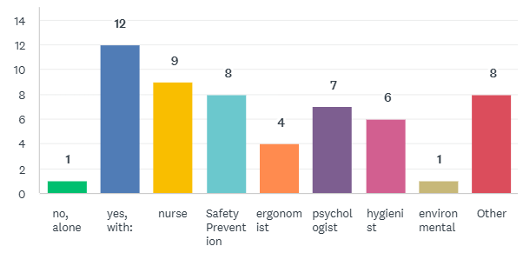
Working in a multi-disciplinary team?

Slide 20
Working in a multi-disciplinary team?
The law only requires the collaboration of a nurse if the enterprise has more than 250 workers. However, and if possible, nurses may be part of the team regardless of the number of workers. The occupational safety engineer, and eventually, also psychologist and ergonomist, may also participate but only in large enterprises or of high risks environments. (Portugal)
Depending very much on the employer. (Switzerland)
The multi-disciplinary team is not mandatory. It is under the responsibility of the OH P who is the coordinator. (Luxembourg)
Psychologists still not so often. Increasing though. (Spain)
Often social worker. (Denmark)
In some cases, not very often (Czech R)

Slide 21
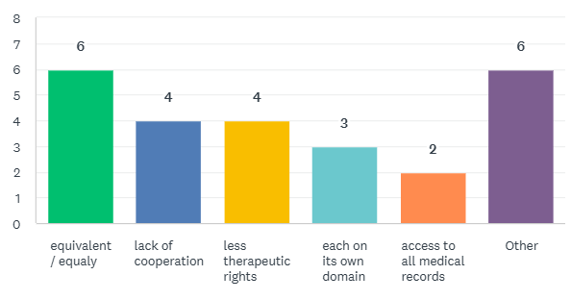
Relationship with colleagues from other medical disciplines / doctors

Slide 22
Relationship with colleagues from other medical disciplines / doctors
On request of the OH P a collaboration is easily possible. (Luxembourg)
OH Ps do not prescribe and do not want to but form a professional standpoint.
  They work with some specialties more than others e.g. pneumologists and psychiatrists. (UK)
An occupational medicine physician can send an employee to a different specialist if needed, in case it's necessary to asses fitness to work. The employer has to pay for these extra visits. (Italy, Poland)
There is also room for improvement in the desired cooperation. (Portugal, Spain)

Slide 23
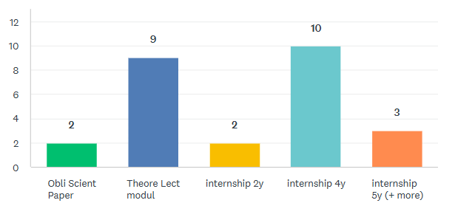
Training for occupational medicine (after medicine training)

Slide 24
Training for occupational medicine
not organized in Luxembourg
4 years (12x)
  4 years specialist training but can also reach specialist status by alternative route without following path (Portugal, UK)
  not easily explainable (Czech R)
5 years (5x)
  2.5 y clinical Speciality and 2.5 y OH medicine (Switzerland)
  2 years of basic (internal medicine) and 3 years in OH medicine (Poland)

Slide 25
Conclusion
No major differences within Europe.
Many Belgian rules we see appearing in a similar way.
Although every country has its own interpretation.
Periodicity is often risk dependent.
The specific periodical medical examinations are often carried out
by a nurse or medical assistant under supervision of an OH P.
(Croatia, Denmark, Ireland, The Nederlands, Norway, Switserland, UK)
The connection with the curative sector is not always easy.

Slide 26
Did you know?
Belgium is the only country that teaches 2 years of theory. (<-> modulair system)
Denmark focuses on occupational diseases
Germany and Norway: periodicity PME of every 3years, risk based e.g. Carcinogens
No training organized in Luxembourg.
The Netherlands mainly focuses on absenteeism: ‘Verzuimbeleid’
UK is very advanced with their specific referral system.
In Switzerland the risks depend on the number of occupational accidents -> paid by the insurance companies.
Medical screening only if there is special exposure or special work conditions,
which cannot be controlled sufficiently by technical or organizational methods.

Slide 27


