Slide 1

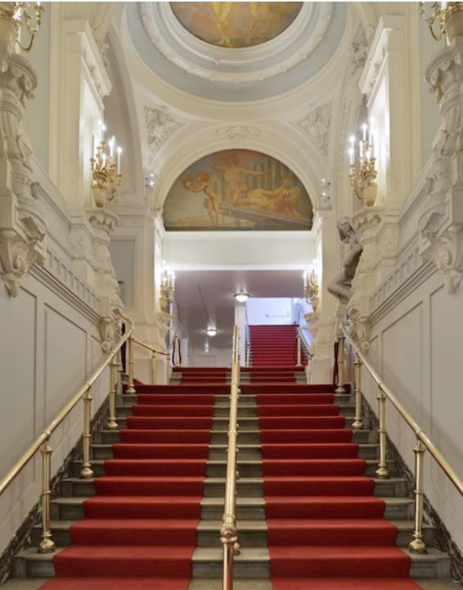

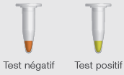
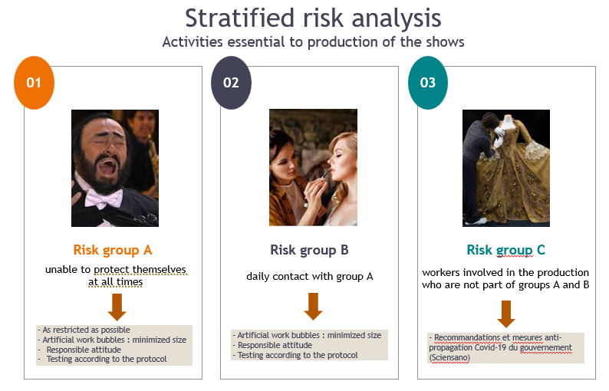
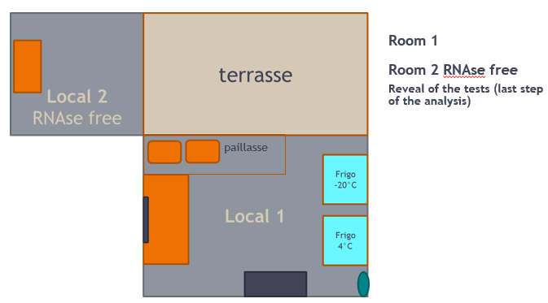
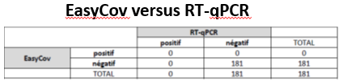
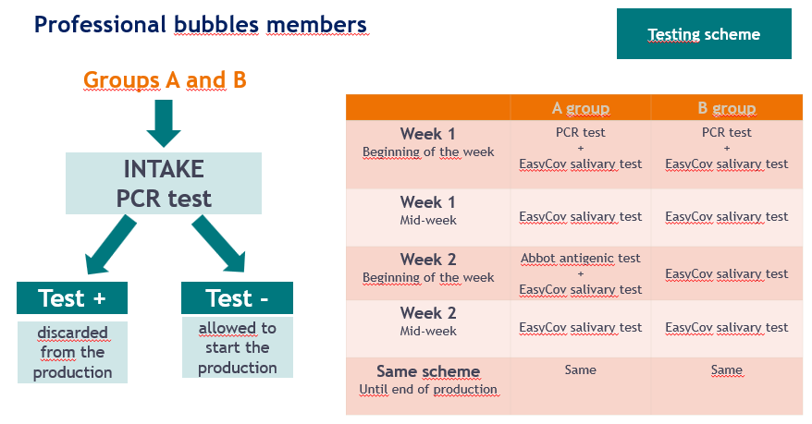
Intra-company SARS-Cov-2 testing at La Monnaie / De Munt during the Covid-19 pandemic (Oct 2020)
Dr Kus G. | Attentia, Prevention and External Protection Service
Objectives
  prevent Covid contamination (Oct 2020)
  allow the production of shows to continue
Testing strategy
    not essential activities
    essential activities
  Testing scheme
Salivary testing
Intracompany test
analysis rooms
Results
> 5000 EasyCov salivary tests performed (from 19/01/2021 to 31/06/2021)
213 pairs of tests EasyCov salivary + RT-qPCR and/or Abbot Antigen
No discordance observed between tests
No contamination observed
Conclusions and learnings
The implementation of a testing protocol specific to working conditions is a major challenge to allow the continuation of work in the context of the Covid-19 pandemic
We did not observe any contamination
We did not observe any discrepancy between the different tests used
The implementation of this type of protocol should be considered when certain workposts do not allow compliance with Covid-19 security measures at all times
Alongside PCR tests and antigen tests, so-called “integrated” saliva tests (EasyCov type) are a possible test option in this type of intra-company testing protocol
  due to their ease of performance (self-sampling, no unpleasant) allowing a better tolerance of workers, their availability, and their affordability
  this human factor is important in the intra-company management of a pandemic, in particular when health measures are prolonged over time
Notes:
To change this poster, replace our sample content with your own. Or, if you'd rather start from a clean slate, press the New Slide button on the Home tab to insert a new page. Now enter your text and pictures in the empty placeholders. If you need more placeholders for titles, subtitles or body text, copy any of the existing placeholders, then drag the new one into place.

