Slide 1


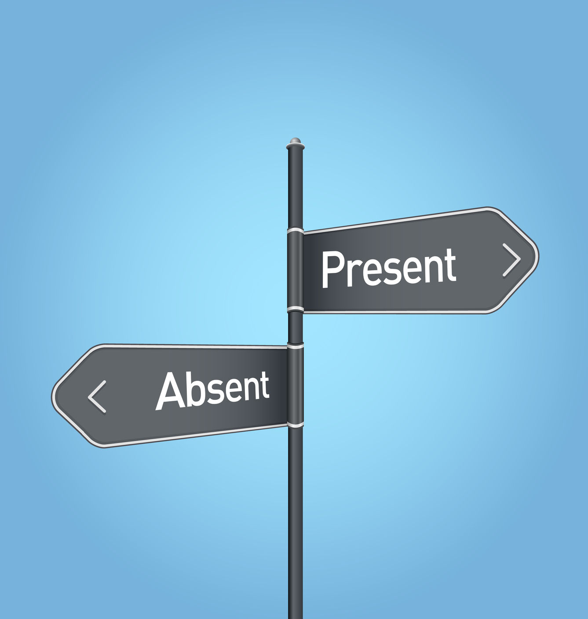
Job quality in relation to attendance behavior
Heidi Janssens
16 december 2015

Slide 2
Outline
1. INTRODUCTION
  Job quality
  Attendance dynamics: sickness absence or presenteeism
  Objectives
2. METHODS
  Study population
3. STUDY RESULTS
Association work quality and attendance behavior (study 1-3)
Association employment quality and attendance behavior (study 4)
4. DISCUSSION
OUTLINE
INTRODUCTION
METHODS
RESULTS
DISCUSSION

Slide 3

Background
Europe 2020 targets of the European Union¹:
“more and better jobs” → essential to
maintain our current welfare state
    More jobs = monitored by employment rates
    Better jobs = job quality
Relation between job quality and a variety of outcomes has been studied:
    Health (psychological and physical)
    Health behavior
    More attitude related outcomes: job satisfaction, leave intention and absenteeism
¹ Europe 2020: A European Strategy for Smart, Sustainable, and Inclusive Growth. EU Facts, Communication for the Commission., August 2010.
OUTLINE
INTRODUCTION
METHODS
RESULTS
DISCUSSION

Slide 4
Job quality
Employment quality
Job quality
Job Demand Control model
Work quality
Social
relations
OUTLINE
INTRODUCTION
METHODS
RESULTS
DISCUSSION

Slide 5
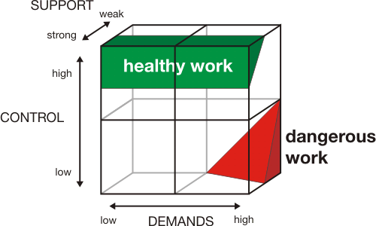
Job quality
Job Demand – Control – Support (JDCS) model van Karasek¹
¹Karasek R, Brisson C, Kawakami N, Houtman I, Bongers P, Amick B. The Job Content Questionnaire (JCQ): an instrument for internationally comparative assessments of psychosocial job characteristics. Journal of Occupational Health Psychology 1998;3:322-355.
OUTLINE
INTRODUCTION
METHODS
RESULTS
DISCUSSION

Slide 6
Job quality
Employment quality
Job quality
Job Demand Control model
Work quality
Social
relations
Effort Reward Imbalance model
OUTLINE
INTRODUCTION
METHODS
RESULTS
DISCUSSION

Slide 7
Job quality
Effort-Reward-Imbalance Model (J. Siegrist)¹
Overcommitment
Intrinsic
(need for esteem)
(personality )
High
effort
Low
reward
Extrinsic
Job Demands
Salary
(situation)
Obligations
Esteem
Opportunities for career and development
¹ Siegrist J, Starke D, Chandola T, et al. The measurement of effort-reward imbalance at work: European comparisons. Social Science and Medicine 2004;58:1483-1499.
OUTLINE
INTRODUCTION
METHODS
RESULTS
DISCUSSION
Notes:
betrokkenheid

Slide 8
Job quality
Employment quality
Job quality
Job Demand Control model
Work quality
Social
relations
Effort Reward Imbalance model
Bullying
OUTLINE
INTRODUCTION
METHODS
RESULTS
DISCUSSION

Slide 9

Job quality
Bullying
Refers to the prolonged and repeated exposure to frequent agressive and hostile behaviors at work, such as excessive criticism, witholding information, spreading of rumors and social isolation, destabilization, threat to personal standing
9-item questionnaire → based on questionnaire of Quine¹
¹ Quine L. Workplace bullying in NHS community trust: staff questionnaire survey. BMJ 1999;318:228-232.
OUTLINE
INTRODUCTION
METHODS
RESULTS
DISCUSSION
Notes:
Bedreiging voor de persoonlijke status

Slide 10
Job quality
Employment quality
Job quality
Job Demand Control model
Work quality
Social
relations
Effort Reward Imbalance model
Bullying
Work Family Conflict
OUTLINE
INTRODUCTION
METHODS
RESULTS
DISCUSSION

Slide 11

Job quality
Work Family Conflict
Definition: interrole conflict in which the role pressures from the work and the family domains are mutually incompatible in some respect.
Two directions:
  Work to home interference
  Home to work interference
Questionnaire of Kelloway¹: both directions strain-based Work Family Conflict
¹ Kelloway E, Gottlieb B, Barham L. The source, nature, and direction of work and family conflict: a longitudinal investigation. Journal of Occupational Health Psychology 1999;4:337-346.
OUTLINE
INTRODUCTION
METHODS
RESULTS
DISCUSSION

Slide 12
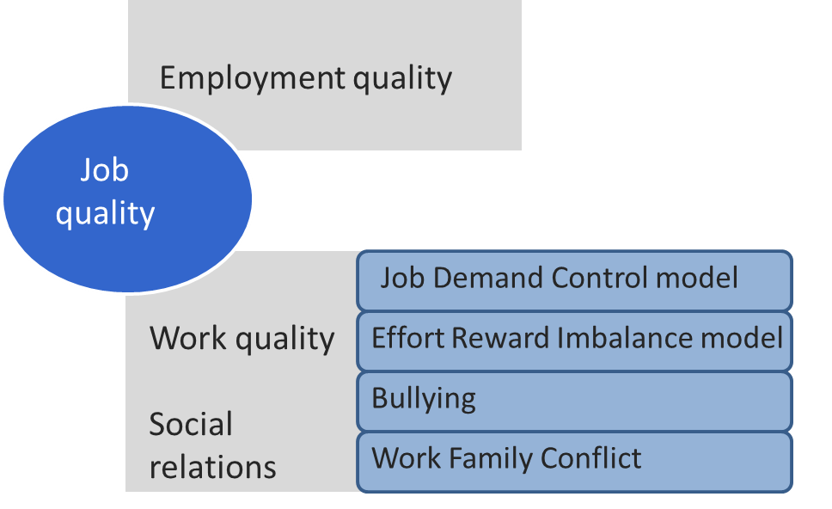
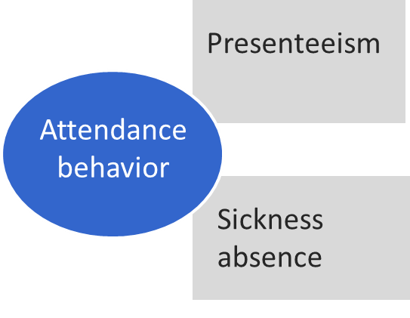
OUTLINE
INTRODUCTION
RESULTS
DISCUSSION
METHODS

Slide 13
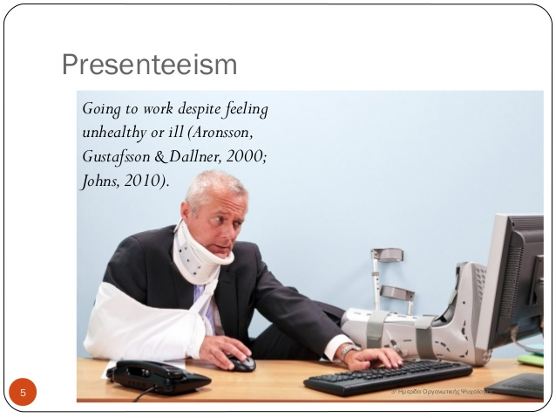
Attendance behavior
Includes sickness absence and presenteeism
The ill worker: “ shall I go to work or shall I stay at home?”
  Sickness absence = not able
  to attend work due to illness or weakened state of well-being
  Presenteeism = going to work despite illness
OUTLINE
INTRODUCTION
METHODS
RESULTS
DISCUSSION

Slide 14
Presenteeism
Table: definitions of Presenteeism (from Johns, 2010)
______________________________________________
Attending work, as opposed to being absent (Smith, 1970)
Exhibiting excellent attendance ( Canfield & Soash, 1955; Stolz, 1993)
Working elevated hours, thus putting in ‘ face time’, even when unfit ( Simpson, 1998; Worral et al.,2000)
Being reluctant to work part-time rather than full-time (Sheridan, 2004)
Being unhealthy but exhibiting no sickness absenteeism (Kivimäki et al. 2005)
OUTLINE
INTRODUCTION
METHODS
RESULTS
DISCUSSION

Slide 15
Presenteeism
Table: definitions of Presenteeism (from Johns, 2010)
______________________________________________
(f) Going to work despite feeling unhealthy ( Aronsson, Gustafsson & Dallner, 2000; Dew et al. 2005)
(g) Going to work despite feeling unhealthy or experiencing other events that might normally compel absence (e.g. childcare problems) ( Evans, 2004; Johansson & Lundberg, 2004)
(h) Reduced productivity at work due to health problems (Turpin et al., 2004)
(i) Reduced productivity at work due to health problems or other events that distract one from full productivity (e.g. office politics) (Hummer et al.,2002; Whitehouse, 2005)
OUTLINE
INTRODUCTION
METHODS
RESULTS
DISCUSSION

Slide 16
Attendance behavior
Health
Personal related factors: age, gender, personality, attitudes
Work contextual factors
OUTLINE
INTRODUCTION
RESULTS
DISCUSSION
METHODS

Slide 17
Objectives
Health & health behavior
Employment quality
Presenteeism
Job quality
Attendance behavior
Sickness absence
Work quality
Social
relations
Job Demand Control model
Effort Reward Imbalance model
Bullying
Work Family Conflict
OUTLINE
INTRODUCTION
RESULTS
DISCUSSION
METHODS

Slide 18
Outline
1. INTRODUCTION
  Job quality
  Attendance dynamics: sickness absence or presenteeism
  Objectives
2. METHODS
  Study population
3. STUDY RESULTS
Association work quality and attendance behavior (study 1-3)
Association employment quality and attendance behavior (study 4)
4. DISCUSSION
OUTLINE
INTRODUCTION
METHODS
RESULTS
DISCUSSION

Slide 19
Study population
Belstress III
European Survey on Working Conditions (ESWC): fifth wave
OUTLINE
INTRODUCTION
METHODS
RESULTS
DISCUSSION

Slide 20
Study population
Database | Number of workers | Year | Job quality indicators | Attendance behavior | Health/ health behavior | Study
Belstress III | 2983 workers (Belgium) | 2004 | Work quality: JDC-model, ERI-model, bullying, WF-conflict | Objective sickness absence Presenteeism | Body Mass Index (self-reported) | 1,2,3
European Survey on Working Conditions | 43.816 participants (EU) | 2010 | Employment quality: Long working hours, Precarious contract, Job insecurity | Self-reported sickness absence Presenteeism |  | 4
OUTLINE
INTRODUCTION
METHODS
RESULTS
DISCUSSION

Slide 21
Operationalization of attendance behavior
Sickness absence
Belstress III: registered sickness absence during 12 months follow-up
  Long term sickness absence: at least 15 consecutive days
  Cause-specific long term sickness absence due to mental health and due to musculoskeletal problems
ESWC: self-reported sickness absence during the past 12 months
Applied as a dichotomous variable: yes/no
OUTLINE
INTRODUCTION
METHODS
RESULTS
DISCUSSION

Slide 22
Operationalization of attendance behavior
Presenteeism
Belstress III: How many times did you come to work despite illness during the preceding year?”
    No
    1 times
    2-5 times
    > 5 times
ESWC: Did you come to work despite illness during the past 12 months?
Applied as a dichotomous variable: yes versus no
No presenteeism
OUTLINE
INTRODUCTION
METHODS
RESULTS
DISCUSSION

Slide 23
Operationalization of attendance behavior
Attendance behavior
Operationalized as a variable containing 4 categories, based on 2 questions from the ESWC (study 4)
No presenteeism/no sickness absence: reference category
Presenteeism without sickness absence
Sickness absence without presenteeism
Sickness absence combined with presenteeism
METHODS
OUTLINE
INTRODUCTION
RESULTS
DISCUSSION

Slide 24
Outline
1. INTRODUCTION
  Job quality
  Attendance dynamics: sickness absence or presenteeism
2. METHODS
  Study population
3. STUDY RESULTS
Association work quality and attendance behavior (study 1-3)
Association employment quality and attendance behavior (study 4)
4. DISCUSSION
OUTLINE
INTRODUCTION
METHODS
RESULTS
DISCUSSION

Slide 25
Study 1
Health & health behavior
Janssens H, Clays E, De Clercq B, De Bacquer D, Casini A, Kittel F, Braeckman L. The association between work psychosocial factors and presenteeism: a cross-sectional study. International Journal of Occupational Medicine and Environmental Health 2016;29(2):331-44
Employment quality
Presenteeism
Job quality
1
Attendance behavior
Sickness absence
Work quality
Social
relations
Job Demand Control model
Effort Reward Imbalance model
Bullying
Work Family Conflict
OUTLINE
INTRODUCTION
RESULTS
DISCUSSION
METHODS

Slide 26
Study 1: Results logistic regression analysis (n= 2983)
Adjusted for gender, age, educational level, seniority, sector, smoking, body mass index, self-rated health, stress outside work, neuroticism
OUTLINE
INTRODUCTION
METHODS
RESULTS
DISCUSSION

Slide 27
Study 2
Health & health behavior
Janssens H, Clays E, De Clercq B, Casini A, De Bacquer D, Kittel F, Braeckman L. The relation between psychosocial risk factors and cause-specific long-term sickness absence. European Journal of Public Health 2014, 24(3): 428-433
Employment quality
Presenteeism
Job quality
Attendance behavior
Sickness absence
Work quality
Social
relations
Job Demand Control model
Effort Reward Imbalance model
Bullying
Work Family Conflict
OUTLINE
INTRODUCTION
RESULTS
DISCUSSION
METHODS

Slide 28
Most important findings:
Bullying: associated with both types of sickness absense
Higher job demands and higher efforts: associated with lower risk for long term sickness absence due to musculoskeletal problems
Higher control: associated with lower risk for long term sickness absence due to musculoskeletal problems
Higher rewards: associated with lower risk for LSA due to menthal health
OUTLINE
INTRODUCTION
METHODS
RESULTS
DISCUSSION

Slide 29
Study 3
Health & health behavior
Janssens H., Braeckman L., De Clercq B., Casini A., De Bacquer D., Kittel F., Clays E., The indirect association of job strain with long-term sickness absence through bullying: a mediation analysis using structural equation modeling. BMC Public Health 2016,16(1):851.
Employment quality
Presenteeism
Job quality
Attendance behavior
Sickness absence
Work quality
Social
relations
Job Demand Control model
Effort Reward Imbalance model
Bullying
Work Family Conflict
OUTLINE
INTRODUCTION
RESULTS
DISCUSSION
METHODS

Slide 30
Study 3: Hypothesized model
Based on the work environment hypothesis
OUTLINE
INTRODUCTION
METHODS
RESULTS
DISCUSSION

Slide 31
Study 3: Results of the SEM
OUTLINE
INTRODUCTION
METHODS
RESULTS
DISCUSSION

Slide 32
Study 4
Health & health behavior
Janssens H, Braeckman L, De Clercq B, De Bacquer D, Clays E.The relation between indicators of low employment quality and attendance behavior in European countries. Journal of Public Health: Accepted for Publication
Employment quality
Presenteeism
Job quality
Attendance behavior
Sickness absence
Work quality
Social
relations
Job Demand Control model
Effort Reward Imbalance model
Bullying
Work Family Conflict
OUTLINE
INTRODUCTION
RESULTS
DISCUSSION
METHODS

Slide 33
Study 4: Results of multinomial regression analysis for attendance behavior
Long working hours
Precarious contract
Job insecurity
Adjusted RRR+/-95% CI
Reference category: no sickness absence combined with no presenteeism
OUTLINE
INTRODUCTION
METHODS
RESULTS
DISCUSSION

Slide 34
Outline
1. INTRODUCTION
  Job quality
  Attendance dynamics: sickness absence or presenteeism
  Objectives
2. METHODS
  Study population
3. STUDY RESULTS
Association work quality and attendance behavior (study 1-3)
Association employment quality and attendance behavior (study 4)
4. DISCUSSION
OUTLINE
INTRODUCTION
METHODS
RESULTS
DISCUSSION

Slide 35
Limitations
Study design and population
  Secondary data analysis
  Cross-sectional
  Representativity
  Response rate
Measurements:
  Self-reports: social desirability, common method bias
  Presenteeism assessment
  Operationalization of attendance behavior
OUTLINE
INTRODUCTION
METHODS
RESULTS
DISCUSSION

Slide 36
Health & health behavior
Job quality indicators are important for sickness absence and presenteeism
  Work quality:
  JDC and ERI models are valuable
  Bullying is an important work quality indicator
  Work environment hypothesis was supported
Employment quality:
Difference between subjective job insecurity and objective measure of insecurity
No clear support for the substitution hypothesis
Employment quality
Presenteeism
Job quality
Attendance behavior
Sickness absence
Work quality
Social
relations
Job Demand Control model
Effort Reward Imbalance model
Bullying
Work Family Conflict
DISCUSSION
OUTLINE
INTRODUCTION
METHODS
RESULTS

Slide 37
Further research
1) Attendance dynamics
Disentangle the dynamic between sickness absence and presenteeism
2) Presenteeism
Developing better measures for assessing presenteeism
Is presenteeism always health harming?
3) Sickness absence
Coping or reflection of health status?
OUTLINE
INTRODUCTION
METHODS
RESULTS
DISCUSSION

Slide 38
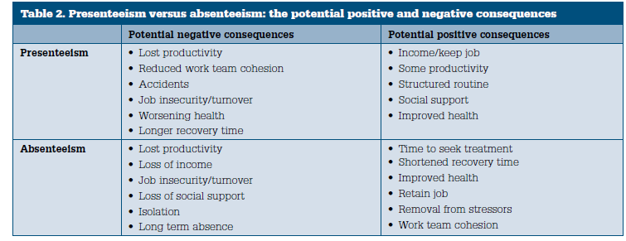
Further research
F. Cocker. Australian family physician 2013; 42:172-176. Presenteeism: implications and health risks.
OUTLINE
INTRODUCTION
METHODS
RESULTS
DISCUSSION

Slide 39
Practical implications
Employer/ Organizational level:
  Be aware of presenteeism
  Do not restrict ‘stress prevention’ to implementation of health improving programmes; also pay attention to change of work characteristics.
  Pay enough attention to the prevention of bullying
Policy makers:
  Limit the possibilities of long working hours
  Focus not only on more jobs, but also on job quality
OUTLINE
INTRODUCTION
METHODS
RESULTS
DISCUSSION

